Slide 2
Learning to Sell Niagara
Ed Merwin – Tridium - VYKON
Scott Boehm – Tridium - VYKON
Jon Jarvis - Tridium

Slide 3
Agenda
New Sales Certification Training Overview
What’s New…
Selling Tools
Online Training Resources

Slide 4
New Sales Training Certification
Niagara Sales^{Pro}

Slide 5
Niagara Sales^{Pro}
Community request to offer structured Niagara training for sales, marketing, and business development roles
Providing a good foundation
  Product knowledge (Tridium & Community)
  Available sales tools,
  Value propositions
  Strategy
Designed for new or experienced employees

Slide 6
Niagara Sales^{Pro}
Establish a professional Niagara sales community
Learn from experienced community members
Share best practices, research, strategies, tactics …
Get your team productive – faster

Slide 7
Niagara Sales^{Pro}
Open to any community member
Pre-work investment – On line
16 Hour Classroom
  ½ day, full day, ½ day
  Richmond & remote
Experienced Instructors
  Tridium Sales Team
  Community
Beta this summer

Slide 8
Niagara Sales^{Pro} Content
Class Assessment
Working with Tridium
  Sales Support
  Community, Portals, Asset Manager
Niagara Basics
  System Architecture
  Products
  Pricing, estimating
  Third Party Products & Services

Slide 9
Niagara Sales^{Pro} Content
Demo Niagara
Industry Trends & Case Studies
Industry Resources
Presenting Open Systems
Cyber Security
Messaging
  Value Propositions
  Stake Holders

Slide 10
Niagara Sales^{Pro} Content
Customer Scenario Project
  Group Exercises
  Find the PAIN!
  Project Value Matrix
  System Proposal
Bring your own project

Slide 11
Selling Tools
New Niagara 4 Demo

Slide 12
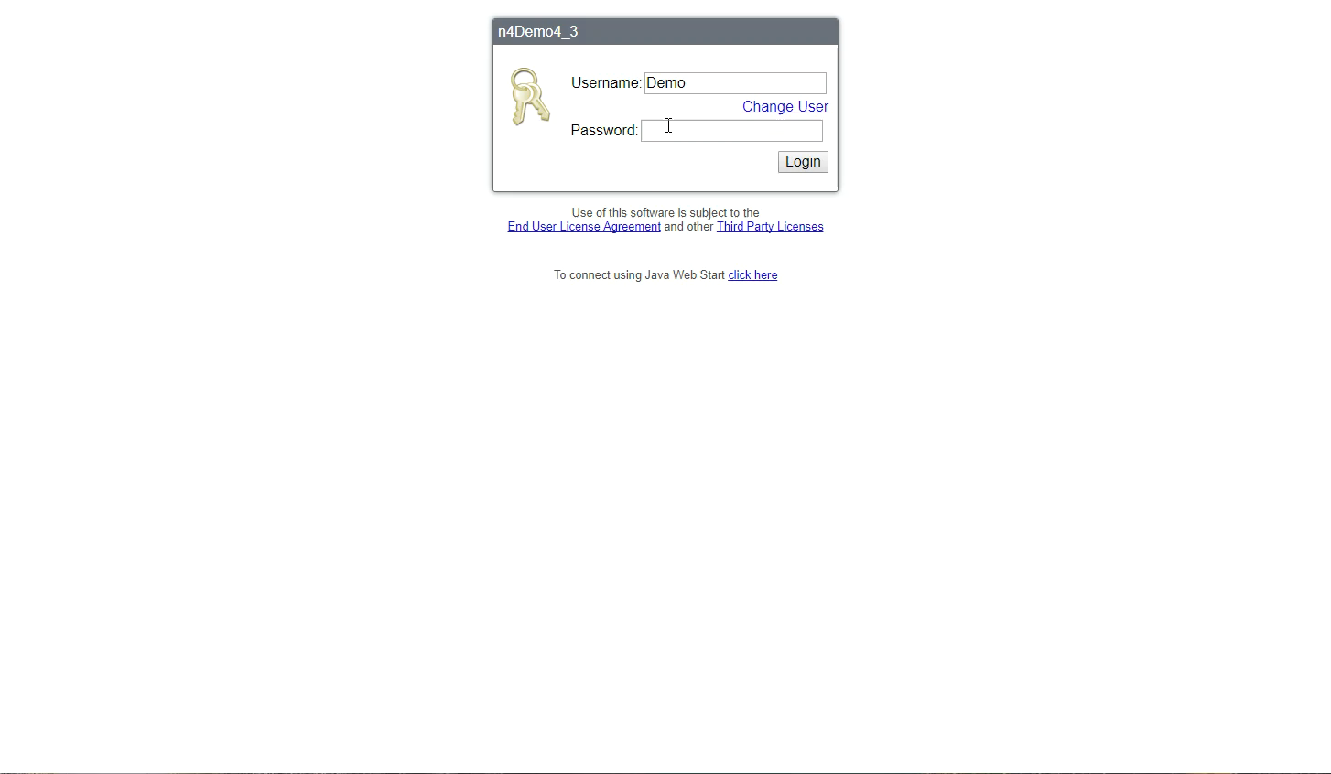
> | East Coast
> | / Average Profile
> | / Area Normalized
> | Westerre II
> | / Energy Dashboard
> | / Spectrum Chart
> | / Relative Contrib
> | / Load Duration
> | / Energy
> | / Floor 3
> | / HVAC
> | // AHU1 Water Leak
> | // VAV301 Alarm
> | /Tag Search
Notes:
Niagara 4 has increased security, Users and Roles for authentication
This is the main landing page for this customer who owns 3 campuses.
1 Building in Boston
4 Buildings in Richmond
1 Building in Boca Raton (athletic Center)

Slide 13
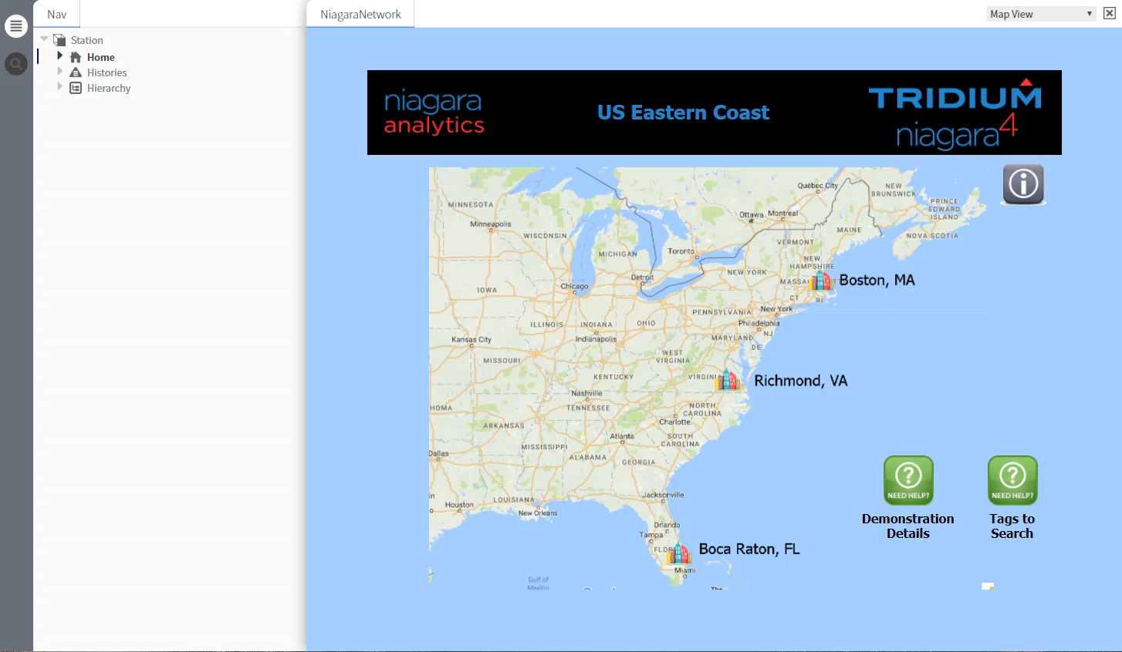
> | East Coast
> | / Average Profile
> | / Area Normalized
> | Westerre II
> | / Energy Dashboard
> | / Spectrum Chart
> | / Relative Contrib
> | / Load Duration
> | / Energy
> | / Floor 3
> | / HVAC
> | // AHU1 Water Leak
> | // VAV301 Alarm
> | /Tag Search
Notes:
Analytics is rolling up information
Shows average consumption over a 24 hour day for each of the buildings

Slide 14
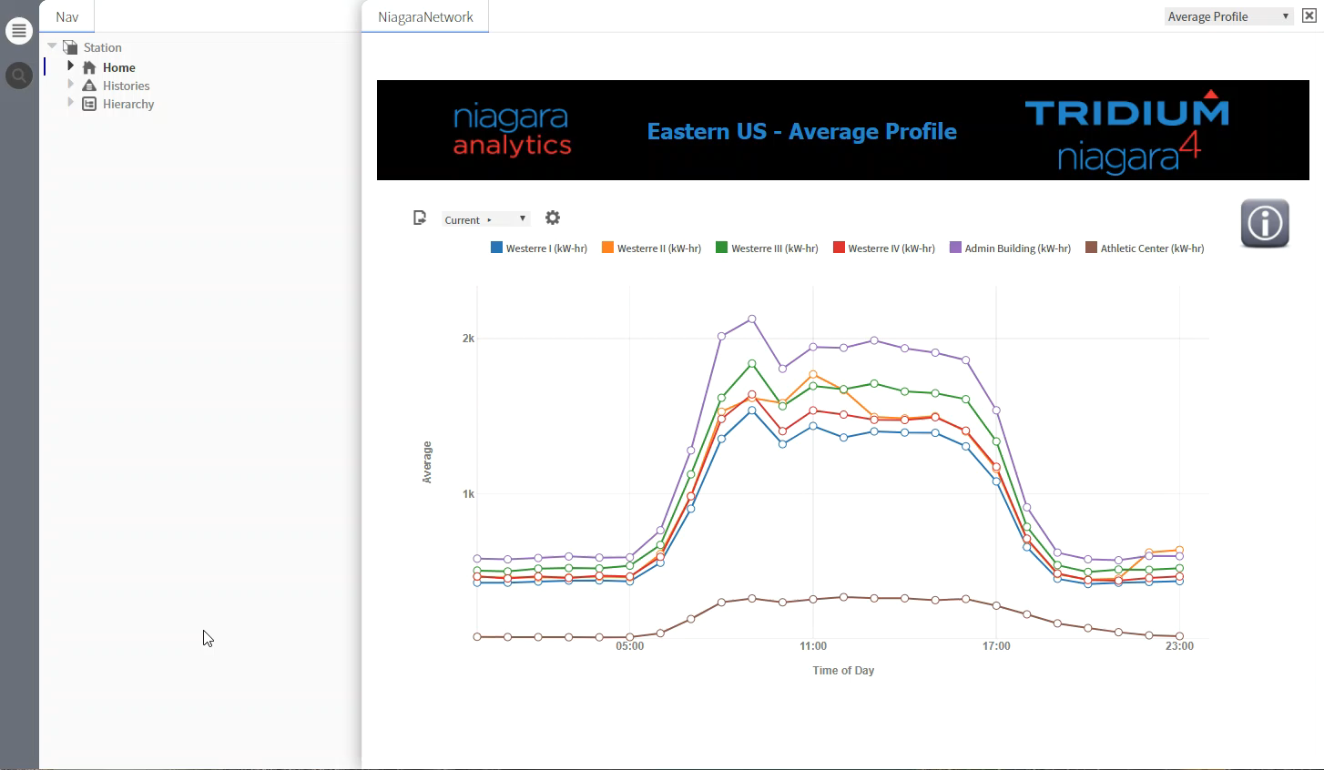
> | East Coast
> | / Average Profile
> | / Area Normalized
> | Westerre II
> | / Energy Dashboard
> | / Spectrum Chart
> | / Relative Contrib
> | / Load Duration
> | / Energy
> | / Floor 3
> | / HVAC
> | // AHU1 Water Leak
> | // VAV301 Alarm
> | /Tag Search
Reply
Notes:
Actual energy usage as compared to energy usage normalized according to building area
Notice that when you look at the graph showing Area Normalized Energy, The Athletic Center shows a more normal usage patter, even on the weekends.

Slide 15

> | East Coast
> | / Average Profile
> | / Area Normalized
> | Westerre II
> | / Energy Dashboard
> | / Spectrum Chart
> | / Relative Contrib
> | / Load Duration
> | / Energy
> | / Floor 3
> | / HVAC
> | // AHU1 Water Leak
> | // VAV301 Alarm
> | /Tag Search
Notes:
Shows Key Performance Indicators (KPI), outside air impact, and demand displayed for individual systems
Left side is Tracking KPI
Shows building
The power of NAT allows you to not watch the graph, but to allow you create an event or alarm when something is out of normal
NOTE: If current demand is 20% greater than the average of the previous hour you have a spike
Using the graph, you could hand calculate the KPI, But the power of NAT…

Slide 16
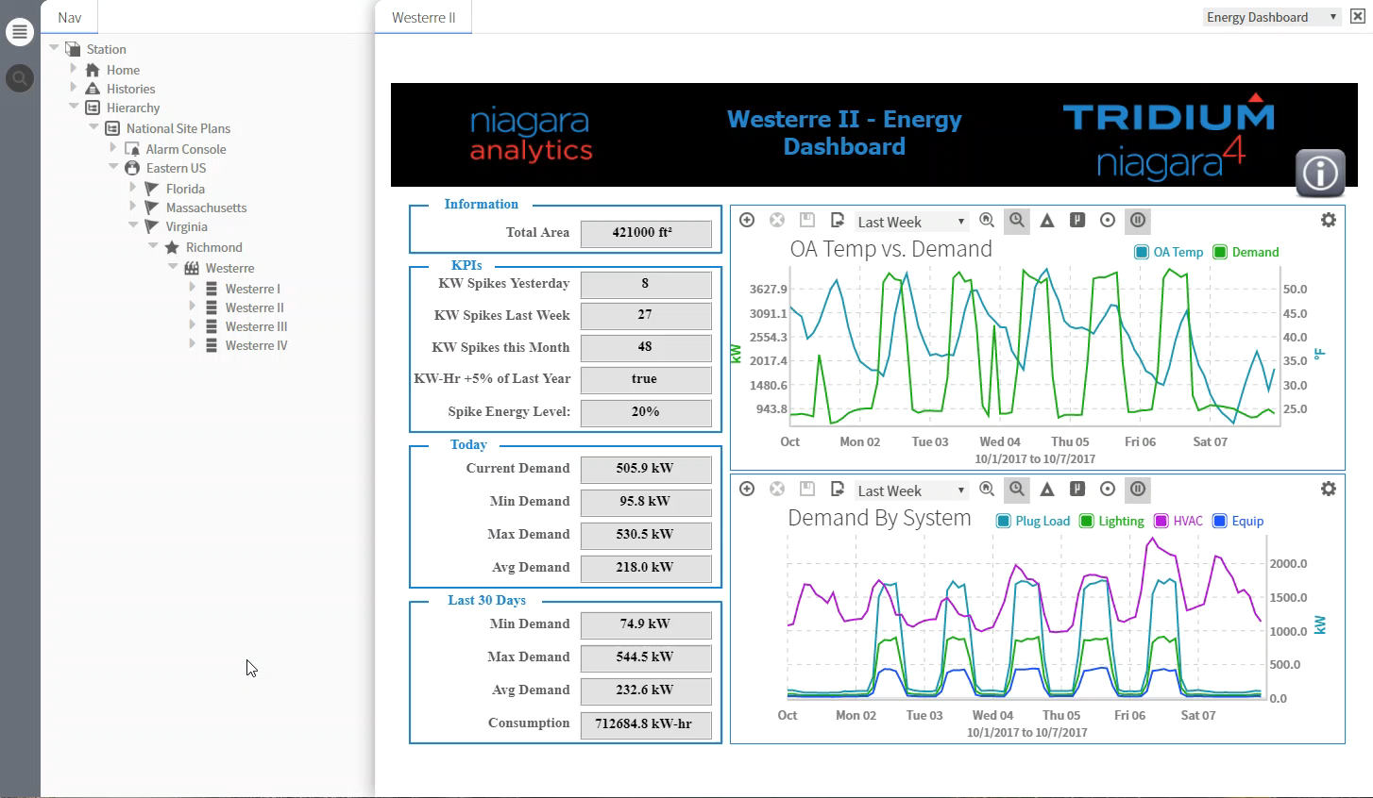
> | East Coast
> | / Average Profile
> | / Area Normalized
> | Westerre II
> | / Energy Dashboard
> | / Spectrum Chart
> | / Relative Contrib
> | / Load Duration
> | / Energy
> | / Floor 3
> | / HVAC
> | // AHU1 Water Leak
> | // VAV301 Alarm
> | /Tag Search
Notes:
Change the HIGH demand to RED
Check out Weekend demand and Early Morning demand. Building owner might want to look into that.

Slide 17
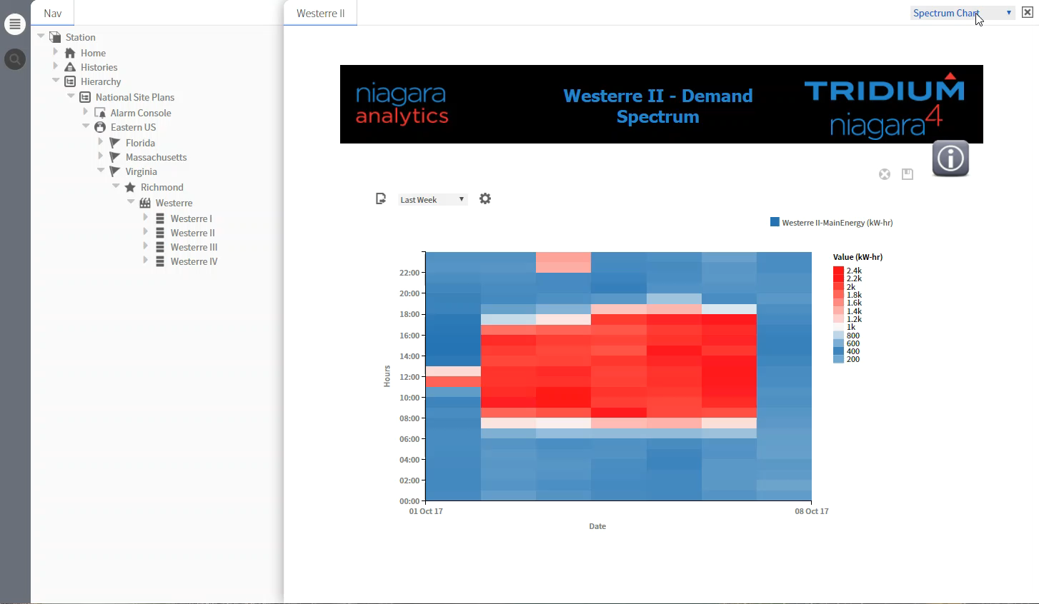
> | East Coast
> | / Average Profile
> | / Area Normalized
> | Westerre II
> | / Energy Dashboard
> | / Spectrum Chart
> | / Relative Contrib
> | / Load Duration
> | / Energy
> | / Floor 3
> | / HVAC
> | // AHU1 Water Leak
> | // VAV301 Alarm
> | /Tag Search
Notes:
Shows relative demand in a pie chart

Slide 18
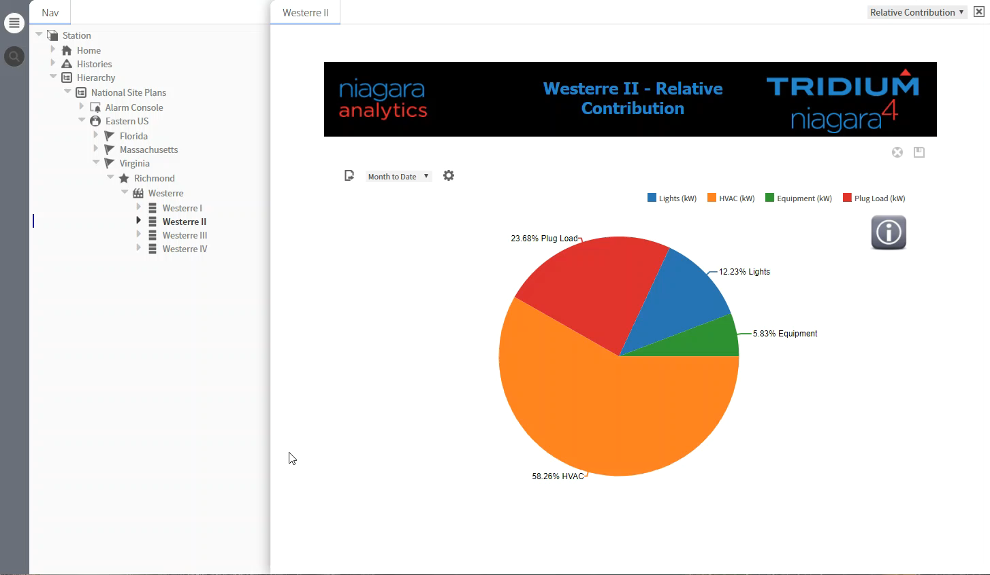
> | East Coast
> | / Average Profile
> | / Area Normalized
> | Westerre II
> | / Energy Dashboard
> | / Spectrum Chart
> | / Relative Contrib
> | / Load Duration
> | / Energy
> | / Floor 3
> | / HVAC
> | // AHU1 Water Leak
> | // VAV301 Alarm
> | /Tag Search
Notes:
This graph provides the ability to identify the duration, or length of time, that demand (or consumption) for a point, aggregate point, or group of points exceeds certain levels. The load duration graph is useful when you are considering using demand-limiting strategies or possible capital investments.
Since demand is a large component of the typical electric rate, you may be able to find significant savings by lowering your peak demand. The date range is user definable, and the benchmark, or baseline, to be compared against is based on historical data within the data point log itself.
The reason you would use this Graph would be to see how much time your peak demand levels are maintained, and try to eliminate the spikes.

Slide 19
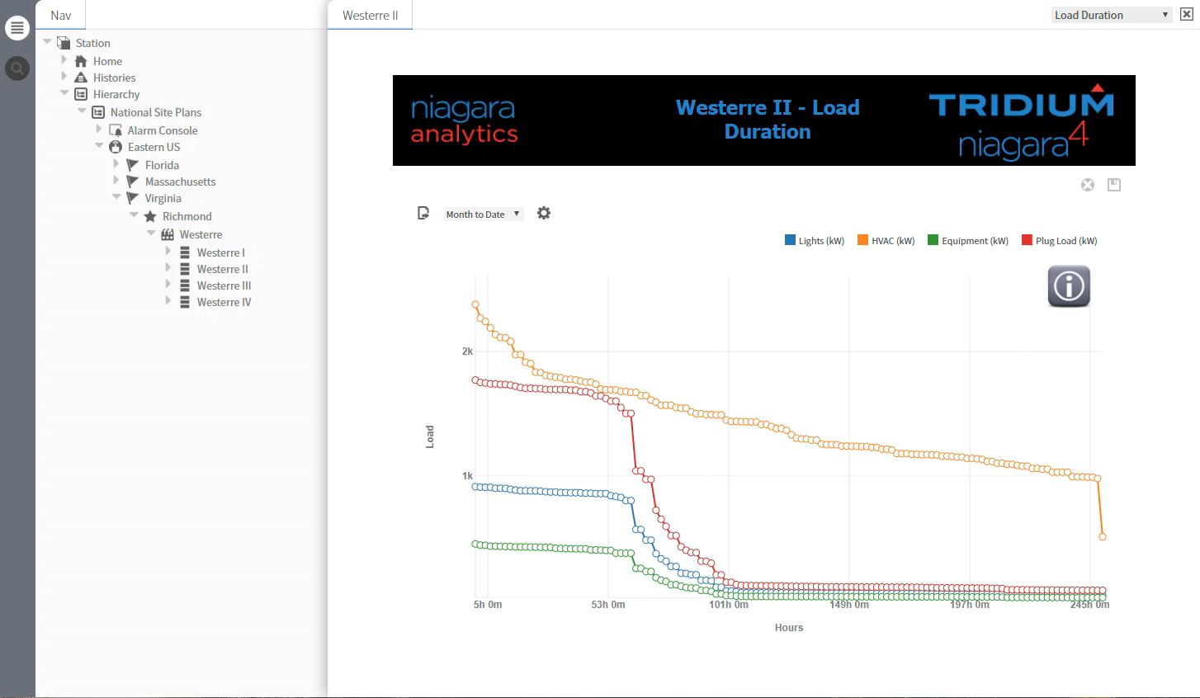
> | East Coast
> | / Average Profile
> | / Area Normalized
> | Westerre II
> | / Energy Dashboard
> | / Spectrum Chart
> | / Relative Contrib
> | / Load Duration
> | / Energy
> | / Floor 3
> | / HVAC
> | // AHU1 Water Leak
> | // VAV301 Alarm
> | /Tag Search
Notes:
1. Showing demand by system: Equipment Load, HVAC Load, Lights Load, and Plug Load
2. This chart has analytics bindings that roll multiple numbers up for displaying the historical data
Graphic is slightly different than the version used on the dashboard, it adds Main Power to the cart to see the total power for comparison.

Slide 20
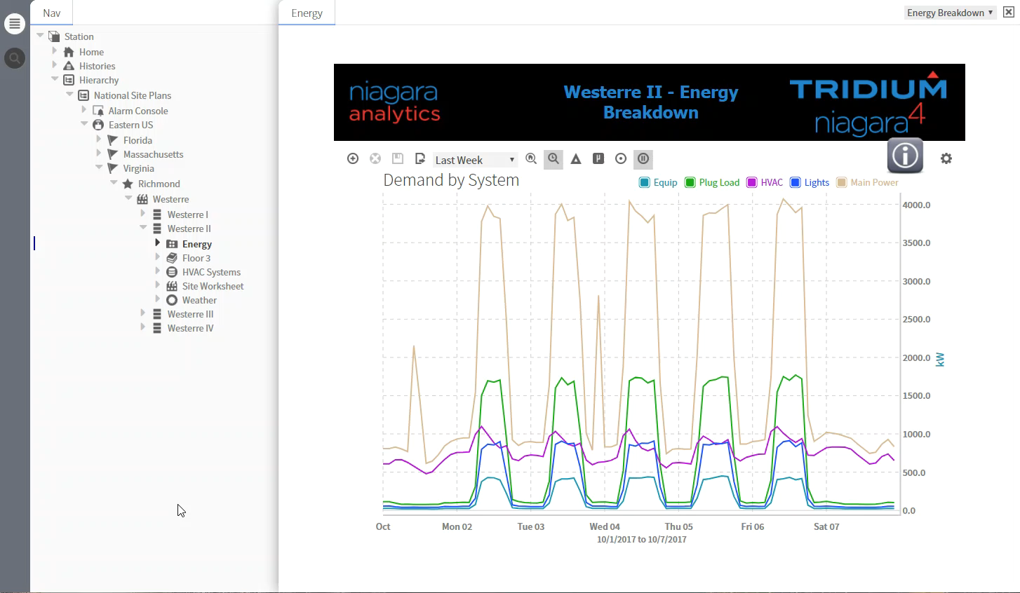
> | East Coast
> | / Average Profile
> | / Area Normalized
> | Westerre II
> | / Energy Dashboard
> | / Spectrum Chart
> | / Relative Contrib
> | / Load Duration
> | / Energy
> | / Floor 3
> | / HVAC
> | // AHU1 Water Leak
> | // VAV301 Alarm
> | /Tag Search
Notes:
The multiple Air Handlers (AHU) are energy hogs.
Using the Niagara analytics tools, this dashboard shows the real-time optimization of the floor using 2 specific algorithms.
Optimizing the static pressure from AHU’s
Looking across all VAVs associated with an AHU for the damper that is open the widest
Using this max damper position, the algorithm will keep that value between 80 to 85% by adjusting the AHU static pressure.
To optimize AHU supply temp to reduce demand on chilled water system
Looking at AHU static pressure
At a pre-defined low static pressure we increase the supply temp. By doing this we decrease the load on the chiller
At a pre-defined high static pressure we decrease the suppy temp. This could increase the load, but it is unavoidable.
Remember the temp stays the same in the room, the ocupents don't feel these optiziation changes.
All this is done on the Edge on the JACE within the building.

Slide 21
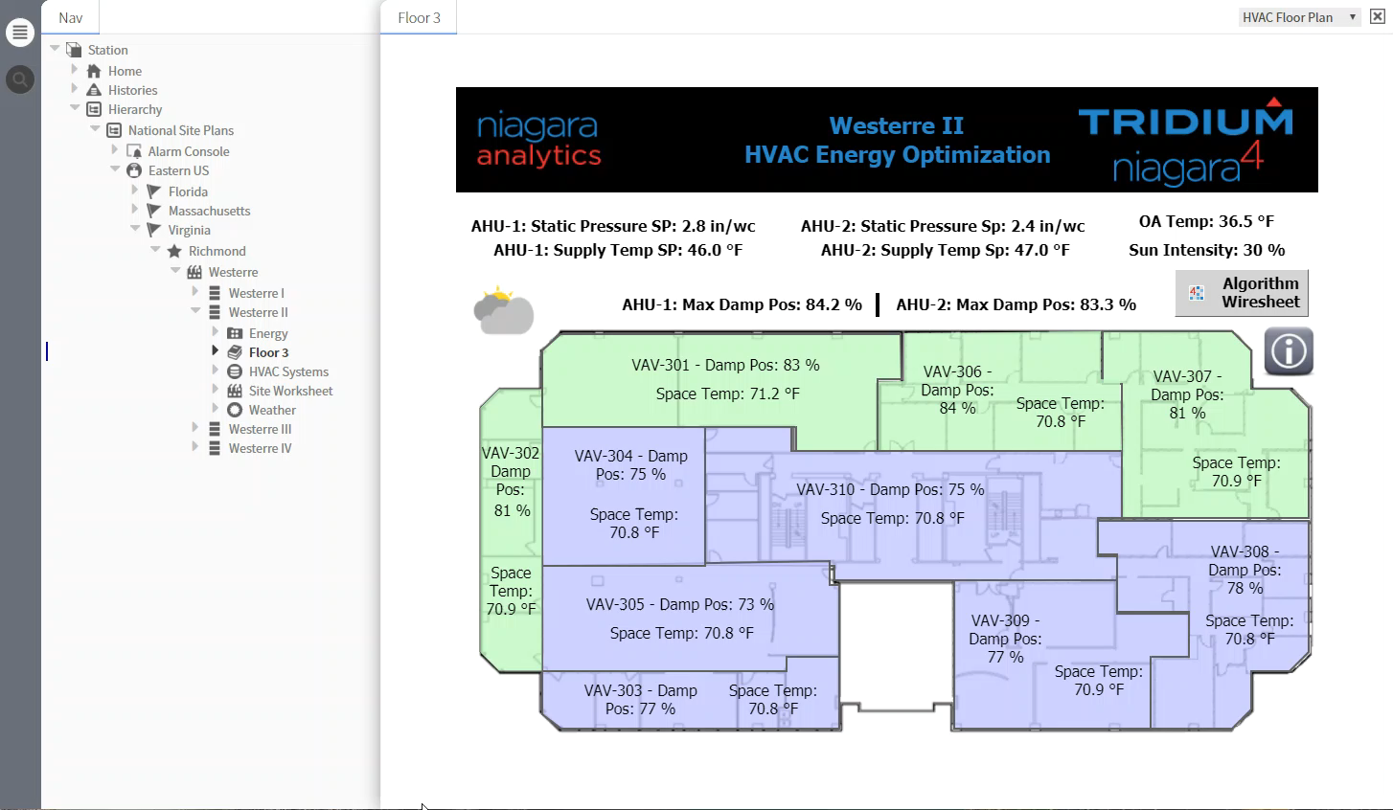
> | East Coast
> | / Average Profile
> | / Area Normalized
> | Westerre II
> | / Energy Dashboard
> | / Spectrum Chart
> | / Relative Contrib
> | / Load Duration
> | / Energy
> | / Floor 3
> | / HVAC
> | // AHU1 Water Leak
> | // VAV301 Alarm
> | /Tag Search
Notes:
By looking at the graphic, you could see there might be a problem, but you could miss it. You could then dig through the history data to see if you have a problem. With NAT, you can run a report and instantly see that there is a problem with Hot Water leaking.
This chart clearly shows the leaking heat valve in light blue along with the spike in Hot Deck Temperature.

Slide 22
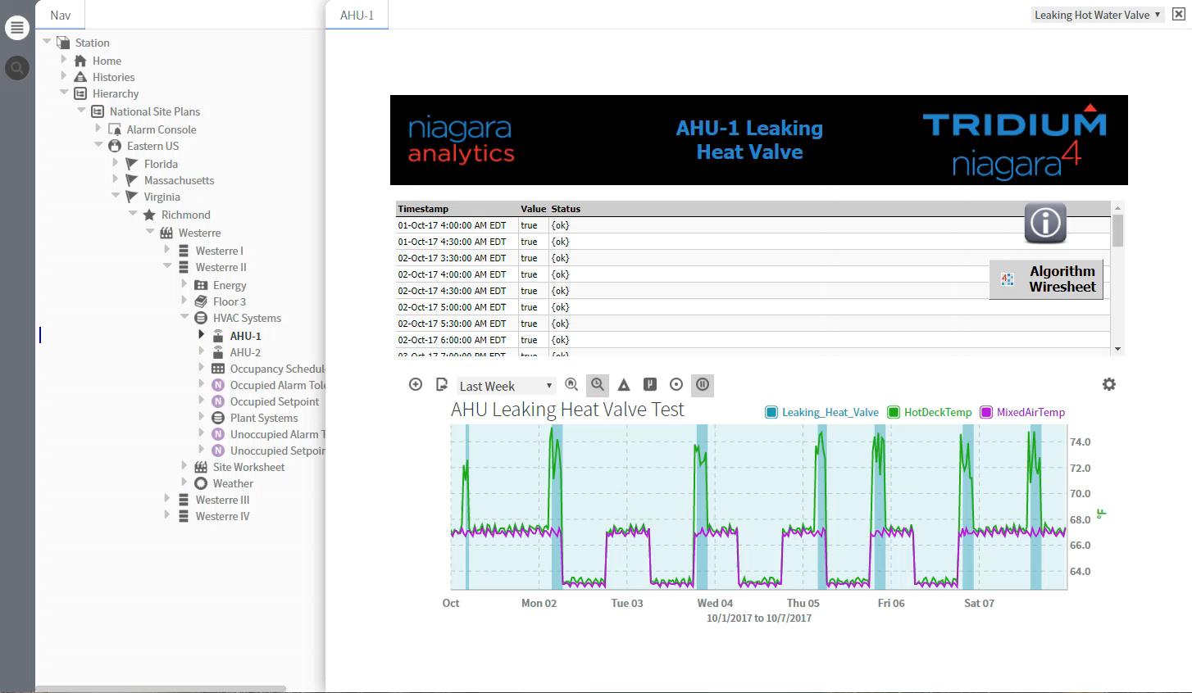
> | East Coast
> | / Average Profile
> | / Area Normalized
> | Westerre II
> | / Energy Dashboard
> | / Spectrum Chart
> | / Relative Contrib
> | / Load Duration
> | / Energy
> | / Floor 3
> | / HVAC
> | // AHU1 Water Leak
> | // VAV301 Alarm
> | /Tag Search
Notes:
Notice the Setpoint is set to 700, and the box flow is lower than the set point.
Setpoint is 700, Damper is 100%, and Flow is below setpoint @ 609
Box is working, but not enough flow, problem is not in the room
With the Analytics tools, your messages become smarter. Instead of High Temp only, you gain insights to not only is the temp High, but the Damper is Open to its max position AND there is low current Flow”

Slide 23
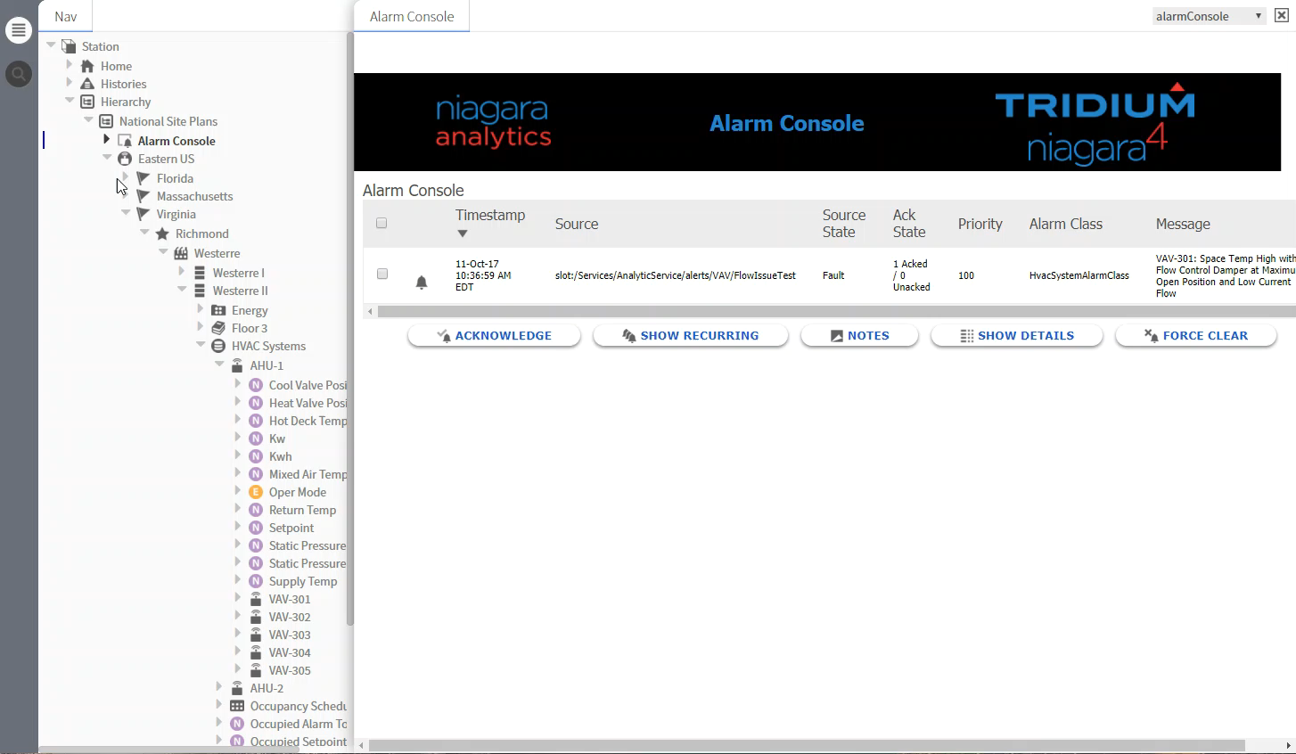
> | East Coast
> | / Average Profile
> | / Area Normalized
> | Westerre II
> | / Energy Dashboard
> | / Spectrum Chart
> | / Relative Contrib
> | / Load Duration
> | / Energy
> | / Floor 3
> | / HVAC
> | // AHU1 Water Leak
> | // VAV301 Alarm
> | /Tag Search
Notes:
Show how easy for the building owner to see all SpaceTemps across all the buildings.
SupplyAirTemp and hs:ahu hs:vav?

Slide 24
Selling Tools
What’s New Updates

Slide 25
Niagara What’s New?

Slide 26
Niagara 4.4 Current Release Overview
Feature
Single Sign On – Supporting an Existing SAML Authentication Scheme | Usability improvement to allow users to log into one stations in their enterprise and then have access to other station without having to re-authenticate.
Improve Performance – System & UI Hierarchy Tag Dictionary Optimization Charting | Ensure the frameworks is performing as optimally as possible. Significant improvement to Web Server page loads
Template Enhancements | Enhances the core Niagara Framework and provides foundational support to Niagara Edge.
HTML 5 Progression HTML5 Alarm Console HTML5 Scheduler | Continue work on Bajaux Field Editors, Manager Views, and improvements to Alarm Console and Scheduler.
Security | Ensure the Niagara Framework is held to the highest security standards.
Last Niagara4 build for Legacy JACEs!

Slide 27
Niagara 4.6 Feature Set Goals
Feature
Single Sign On – Support using an Internal SAML Authentication Scheme | Usability improvement to allow users to log into one stations in their enterprise and then have access to other station without having to re-authenticate.
System Search & Hierarchies via a Supervisor (aka Enterprise Search) | Provide an on premise solution for end users and system integrators to easily navigate through their entire Niagara Network.
Guest Account | Allow users to enable a “guest” mode for use in kiosks and digital signage.
HTML 5 Progression | Improve mobile user experience and support
FIPS 140-2 in N4 | Unlocks the ability to sell into the federal govt.
Security | Ensure the Niagara Framework is held to the highest security standards.

Slide 28
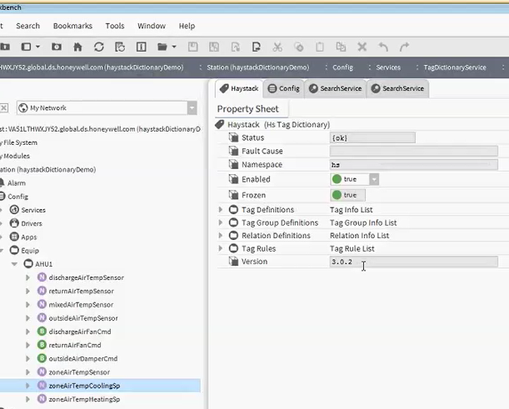
Updated Haystack Support
Haystack dictionary updated to 3.0.2 in Niagara 4.4
Outdated tags are not allowed for future use.
Outdated tags are still usable.

Slide 29

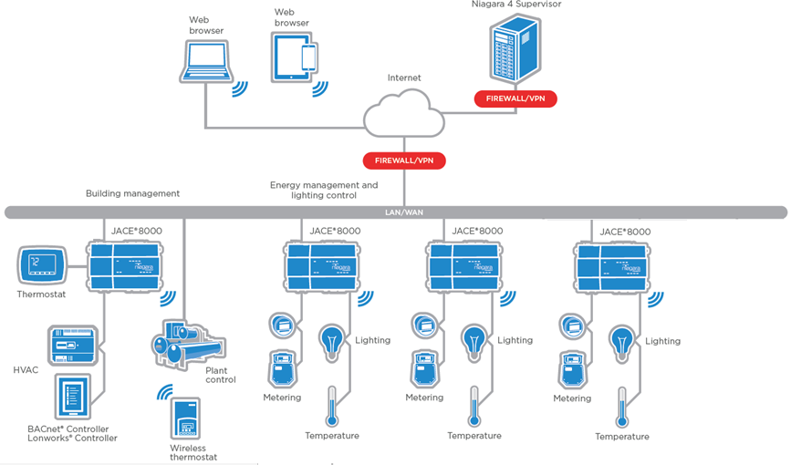
System DB
4.6

Slide 30
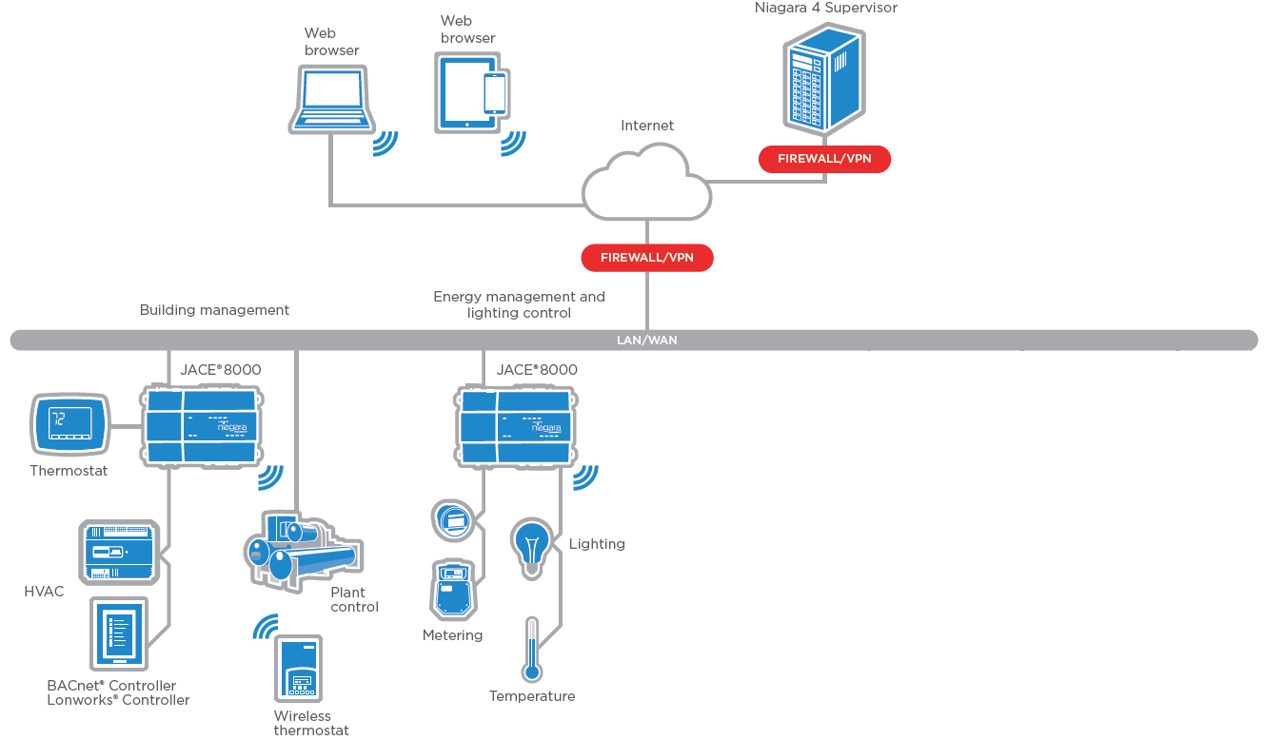


Niagara Edge Tools – Auto Join
4.6

Slide 31



Niagara Edge Tools – Config Updates
4.6

Slide 32

Niagara Edge Tools – Certificate Mgmt
4.6

Slide 33
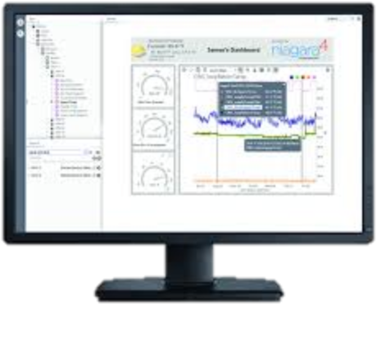

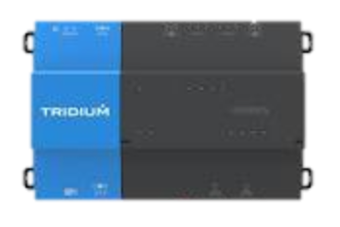



Niagara Edge
Enterprise / Cloud
Niagara Supervisor
Connect to edge devices via Niagara and non-Niagara controllers
Supervisory Controllers
Connect directly
to edge devices via Niagara software installation
JACEs®
3rd party hardware +
Niagara Edge software
Edge Ecosystem
AHU
RTU
Physical Plant
Equipment
Processes
AHU
RTU
Physical Plant
Equipment
Processes

Slide 34
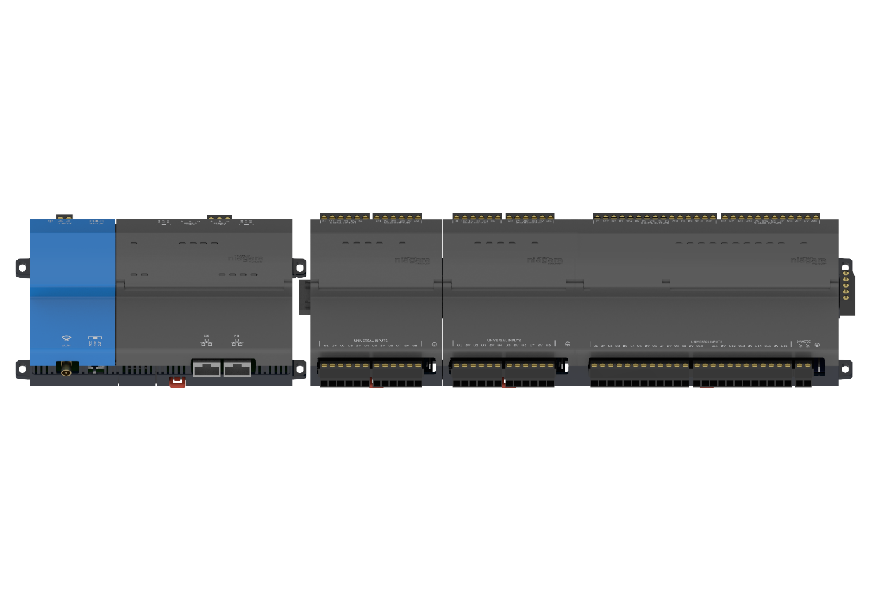
IO R Remote IO Modules
Ease of use: Single-tool programming inside the Niagara environment with live debugging
Enhanced capability: Ability to set hold time and default states for outputs based on application needs
Improved flexibility: Operates over an RS485 network and can be installed anywhere. Multiple modules can be combined so each JACE 8000 can command more than 250 points of IO
Minimal wiring labor: Quick three-step process when moving from NDIO to the JACE 8000

Slide 35
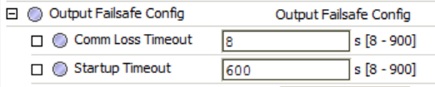
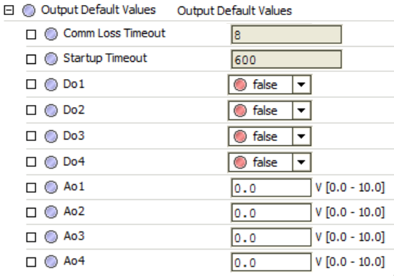
New Feature: Programmable Default Output States
IO-R can be configured to drive output states to known safe states when fault scenarios are active.
Configurable Timers
Configurable timer to hold current state before changing to default
Configurable Default values:
  Analog Outputs: 0 to 10v
  Digital Outputs: True/False

Slide 36
JEC-834

Slide 37
JEC-834
Replacement platform for JEC-234 and JEC-334!
Package includes:
  JACE 8000
  IO R 34
  Licensed for:
  Standard open drivers
  Drivers Licensed for 0 devices & 0 points
  Requires Niagara 4.3 or higher.

Slide 38
JEC-834
VYKON PART #'s | DESCRIPTION | LONG DESCRIPTION | LIST PRICE
JEC-834 | JACE®8000 Equipment Controller | JACE® 8000 with remote connected 34 point I/O module. Includes microSD card, 2 10/100 Mb Ethernet ports, 2 RS-485 serial ports and integration ready. Includes standard open drivers with 0 device & 0 point capacity. Requires 24 VAC or 24 VDC power source. Option cards required for communication to remote devices are not included. Requires Niagara 4.3 or higher. | $ 2,140.00
DEVICE-1 | 1 Device Capacity Pack | JACE-8000 1 Device/50 Point Capacity Pack purchased in conjunction with initial Core software. Only available on JACE-834 and NC-8000-EC software cores. | $ 275.00
DEVICE-UP-1 | 1 Device Upgrade | JACE-8000 1 Device/50 point upgrade. Available any time after initial core software purchase. Only available on JACE-834 and NC-8000-EC software cores. | $ 300.00
SMA-8005-1YR-INIT | JACE 8005 - 18 mo Maintenance | JACE 8005 - Initial 18 month maintenance must be purchased in conjunction with initial Core software. Optional 3 or 5 year maintenance may be substituted. | $ 110.00
* Same List Price as JEC-334, but not as restrictive.
** Refer to current List Prices.

Slide 39
Niagara 3.8U3

Slide 40
Niagara^{AX} 3.8U3
IO R Support for the JACE-8000
For installations where AX is still deployed, use Tridium’s latest IO and JACE offering while planning the jump to Niagara 4
TLS 1.2 Support
Use the latest industry standard for Transport Layer Security in your building network.
New Secure Cipher Suites
New ciphers suites now available in AX to keep your Niagara system running securely.
Legacy Platform Improvements
Have a JACE 3E, 6, 6E or 7? Memory optimization routines to improve platform performance.

Slide 41
In case you missed the memo
Excerpts from January 26th 2018 Tech Bulletin

Slide 42


Mitigating Meltdown and Spectre CPU Hardware Security Flaws

Slide 43
IMPACTS
Supervisors that run on Windows or Linux platforms
  These machines can be affected
  Follow Cyber-security best practices for PC platforms
  Make sure that you and your customer’s organizations have patch management plans in place

Slide 44
IMPACTS – JACE Hardware
Investigation continues here’s what we know:
Legacy JACE Hardware:
  JACE 2/3/6/7 families use a much older PPC architecture, our vendor has determined that they are not susceptible to Spectre and Meltdown.
JACE-8000:
  NOT affected by Meltdown.
  The ARM CPU that is reportedly vulnerable to Spectre

Slide 45
A Spectre attack requires malware execution
Niagara4 and JACE 8000 Security controls include (but are not limited to) the following:
  The JACE-8000 employs a “secure boot” processor that provides non-repudiated assurance that the root image wasn’t tampered with.
  Niagara 4 employs integrity validation of the core framework at run-time, validating the digital signatures of all Niagara run-time components.
  Niagara 4's Security Manager provides malware prevention by “sandboxing” third party modules
  Niagara 4 limits administrative controls and access to sensitive areas of the Niagara Framework to authenticated administrators with platform access.

Slide 46

Enterprise Security Roadmap

Slide 47


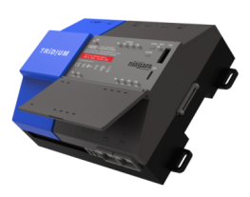
Enterprise Security Roadmap
Enterprise Security 2.3 U1 – Released June 2017
  Release of database API – LDAP integration, rdbms integration for databases such as PeopleSoft, etc.
  Easy Lobby Visitor Management Driver
  Support for Security Application on JACE 8000 platform
  Updated video drivers for Milestone and Axis
  Based on Niagara AX 3.8 U2
Enterprise Security 2.4 – July 2018*
  Based on Niagara 4.6
  Eliminate applet dependency in browser UI
  JACE 8000 running Niagara 4.6
  All previously supported functionality
  Updated video framework API
*Note: Dates and features listed above are forward looking targets and are subject to change.

Slide 48

Enterprise Security Roadmap
Enterprise Security 3.0 – 2019*
  Move from Security Application to Security Platform
  "Build your own UI" using security widgets and dashboard tools
  Add differentiating features to your security offering using APIs and custom programs
  Differentiate with your special set of integrations using APIs for security
*Note: Dates and features listed above are forward looking targets and are subject to change.

Slide 49
Niagara eSignature Module

Slide 50
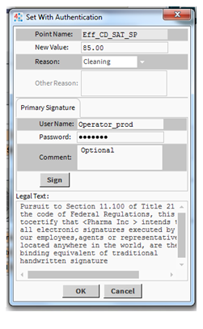
For projects requiring secured authenticated documentation such as 21 CFR Part 11
Native Niagara module
Converts points to secure points
Creates secure point histories
Actions on these points require username and password authentication
Niagara based user configuration management

Slide 51
Backup as a Service

Slide 52

BaaS solves unique challenges
24/7 access to a copy of a JACE station should it be necessary to restore
Single JACE projects can enjoy the benefits of automated backups
Back up your data and safeguard your business with Niagara Cloud

Slide 53
Niagara Cloud

Slide 54
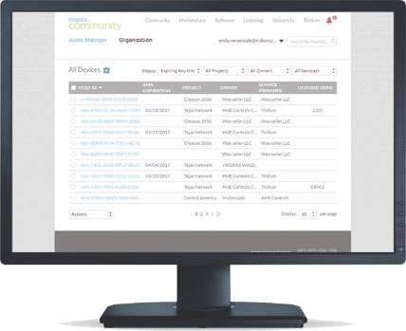
Asset Manager
Organization access
  User access is managed at the enterprise level
  Register your organization with the asset manager as a first step to Niagara Cloud
User permissions
  Users
  Device Manager
  Organization Manager

Slide 55
Enterprise License Management

Slide 56
Issues
Management of multiple brands of Niagara Framework Licenses
Keeping track of SMA dates and versioning
Managing periodic Station backups

Slide 57
Tridium Trade Up Program 2018

Slide 58
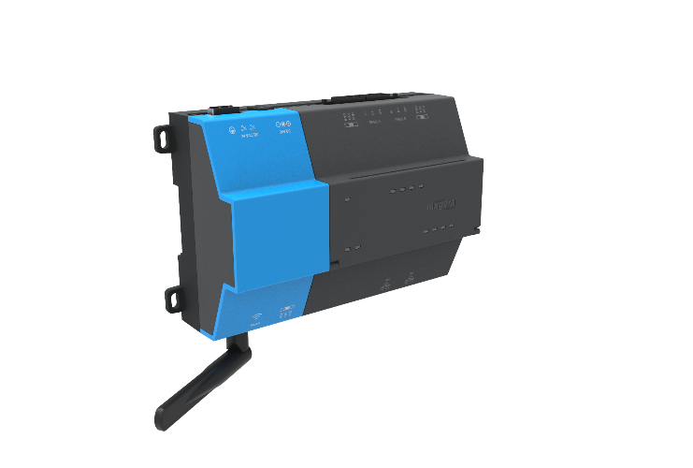


TUP 2018 – Experience Analytics
Program Outline: Trade in your old Legacy JACE for a JACE-8000 and get an additional 975 Niagara Analytic points plus NA Training!
  Analytic feature increased from 25 to 1000
Still using AX? Need time to transition?
AX license included
JACE-8000
+1000 Analytic Points
Training Included
One seat for SI and one for End User see details
$1500 savings per JACE
$1500 savings per project
$900 savings per JACE

Slide 59
TUP 2018 – Enterprise Discount
Program Outline: For larger trade ups, in addition to the analytics package these orders will also be eligible for an additional 10% discount on the software license
Trade in orders of 15 legacy JACEs or more
10%
Discount on 8100 or 8200 only
$750-1100 savings per JACE

Slide 60
Available Training Resources
Online
Community

Slide 61




Tridium U Platform
Training Partners
Colleges/CEU
Continual Education Anytime, Anywhere
Tiered Certification
Online Communities
ELEARNING
Panels in the Cloud
VIRTUAL
Smart, Connected People
ILT
LMS in CRM
Market Place
IoT Training Portfolio
Tridium
U
Partner Ecosystem
Notes:
Need to build an Educational Platform, that offers a full portfolio of training, delivered via multiple methods (ILT, Virtual, eLearning), Educated anytime, anywhere, and develop Centers of Excellence around the globe with local regions with training partners, academia, and trade associations.

Slide 62

Tridium University Overview

Slide 63
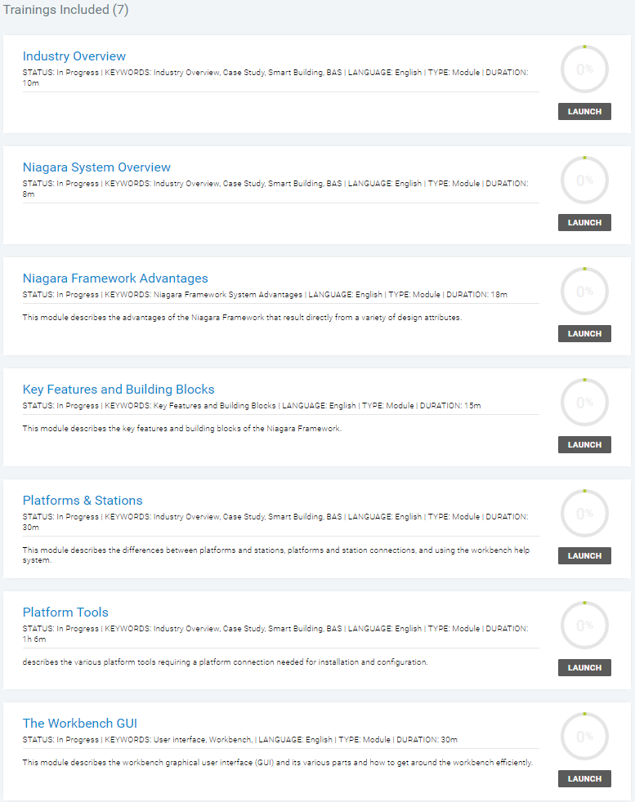
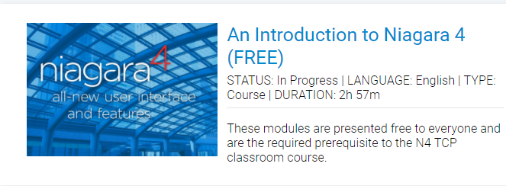
An Introduction to Niagara 4 (FREE)

Slide 64
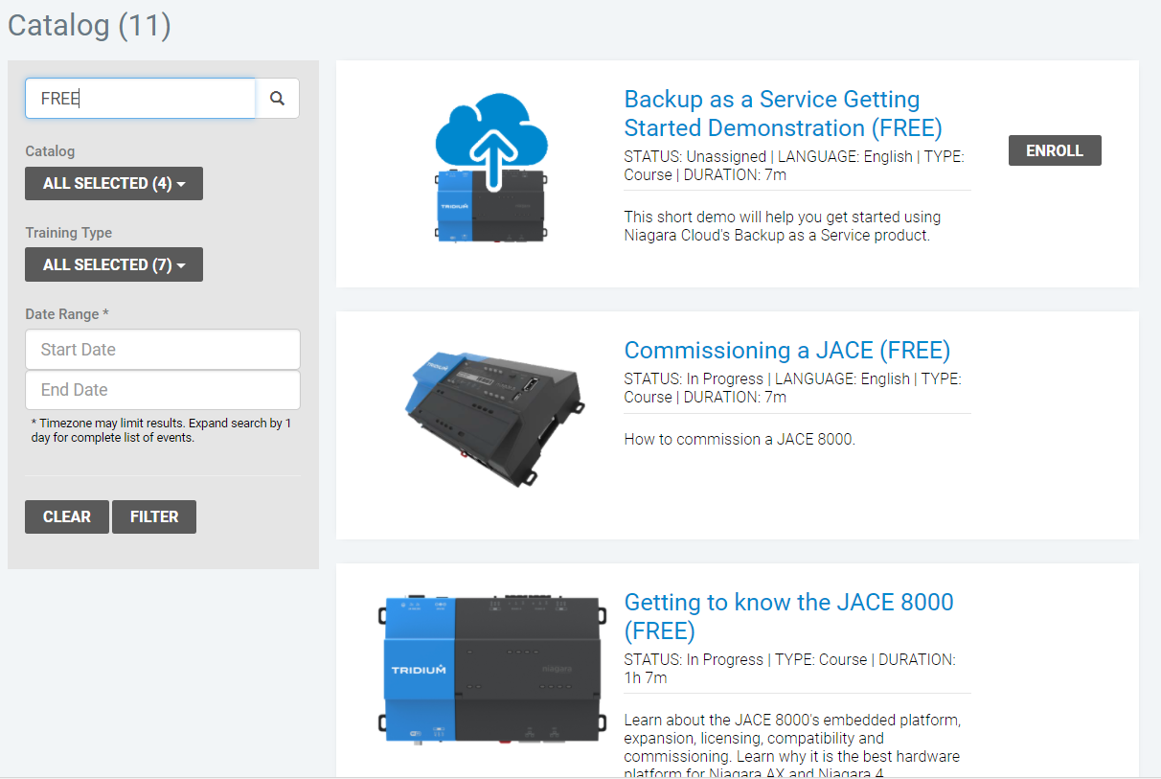
FREE Trainings
Niagara Community Account
Search “FREE”
Enroll in eLearning

Slide 65
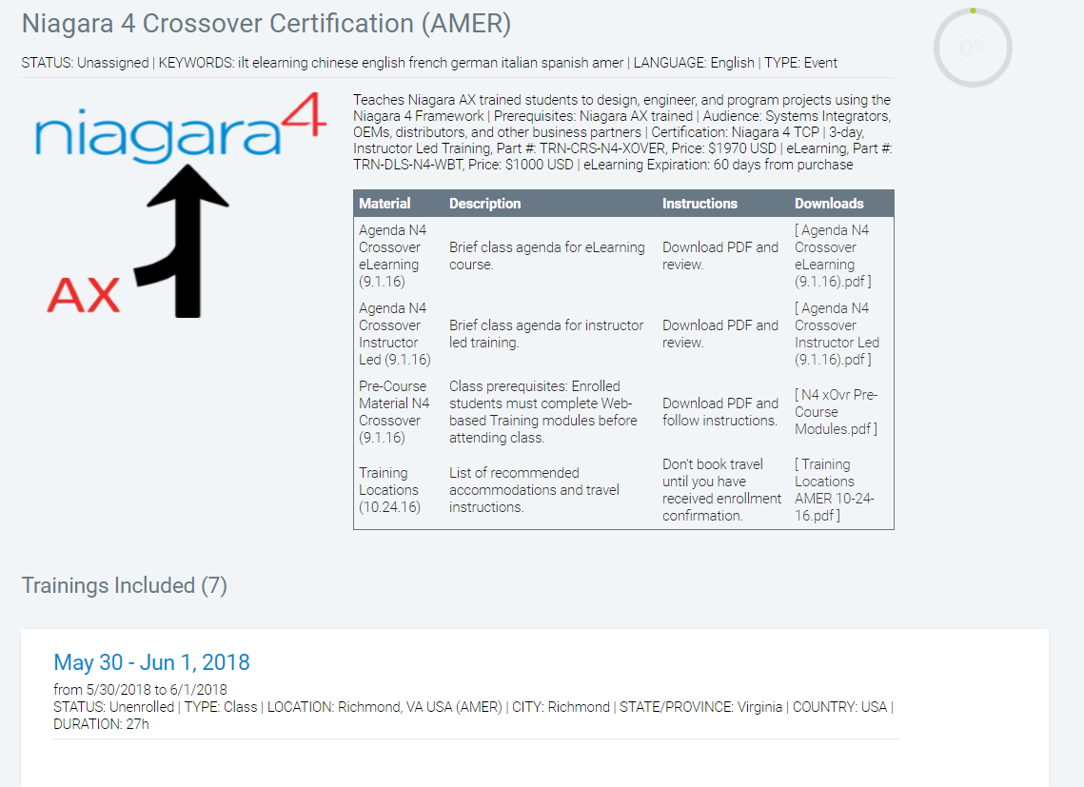
Niagara 4 Crossover Certification

Slide 66
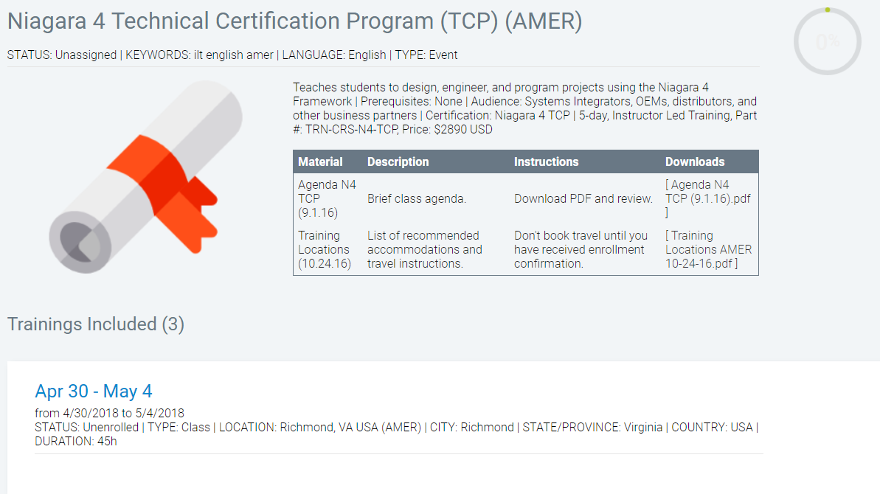
Niagara 4 TCP

Slide 67
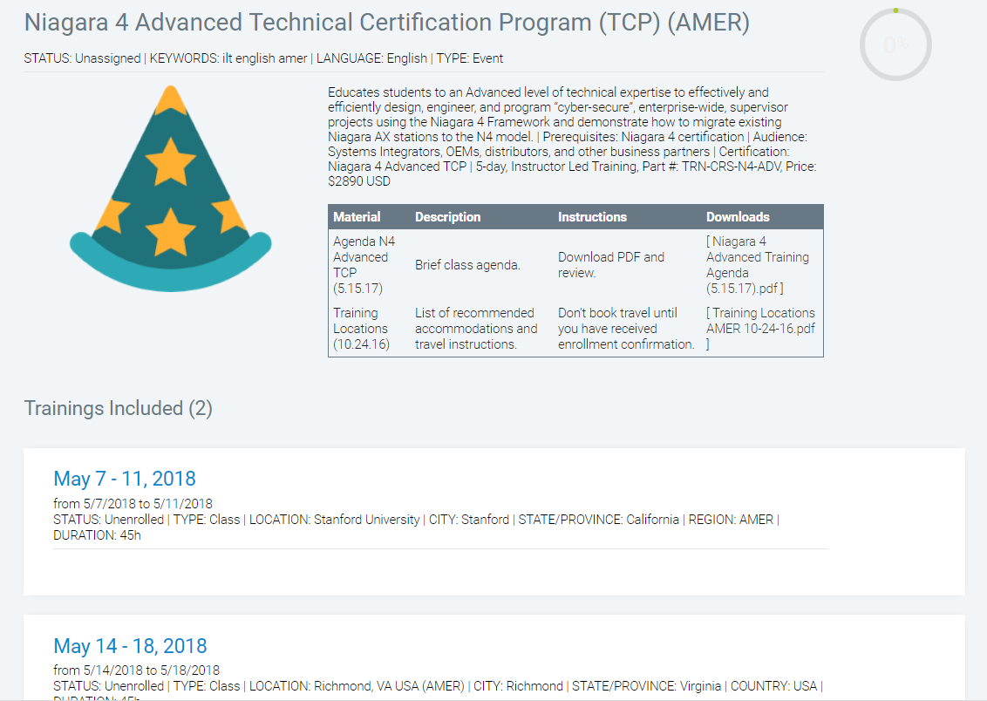
Niagara 4 Advanced TCP

Slide 68
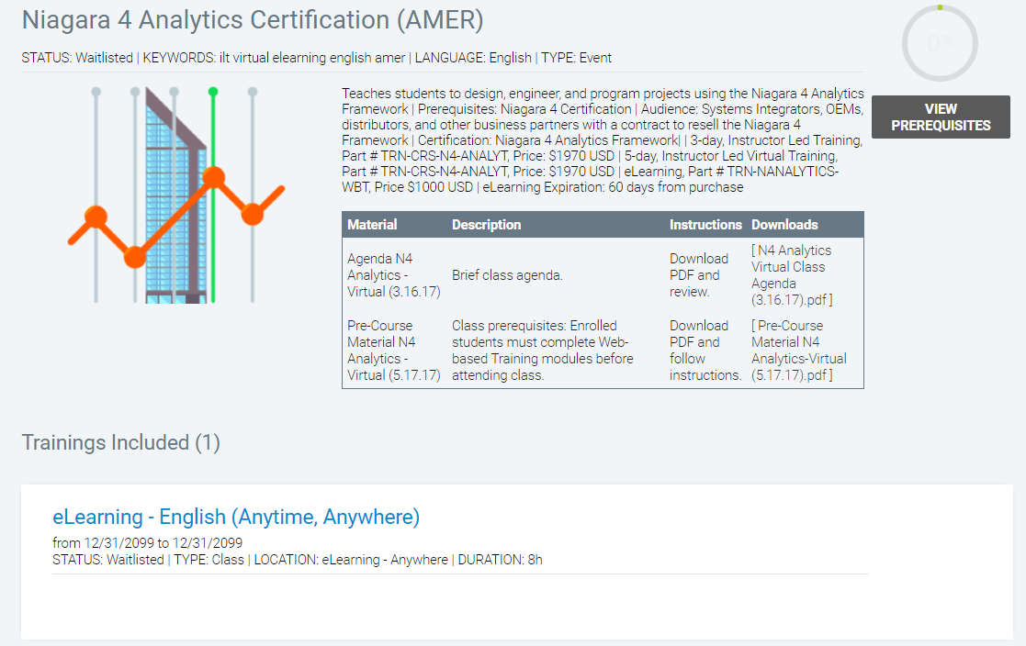
Niagara 4 Analytics Certification

Slide 69
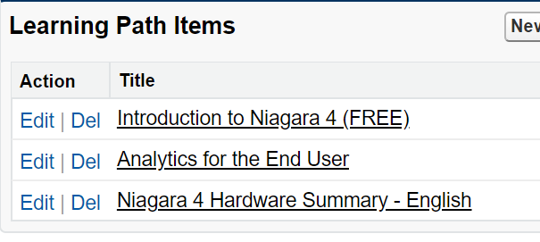
Niagara 4 Analytics End User
Part of Trade Up Program
1 seat for End User
Can purchase additional seats for $400 NET, $500 MSRP
TRN-N4ANL-EU-WBT

Slide 70
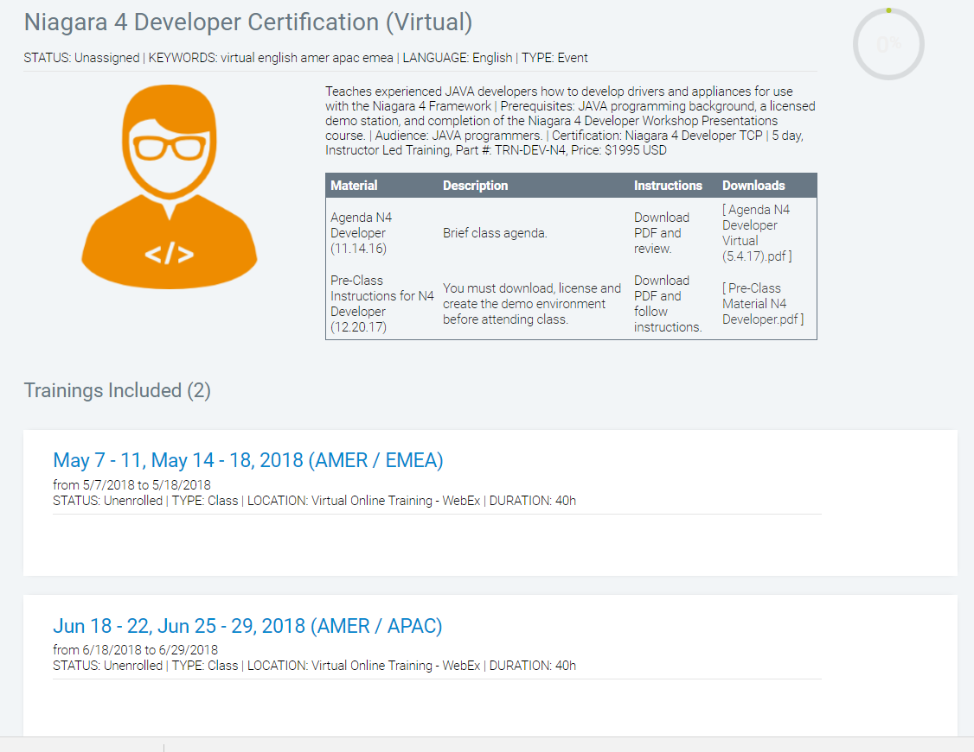
Niagara 4 Developer Certification

Slide 71
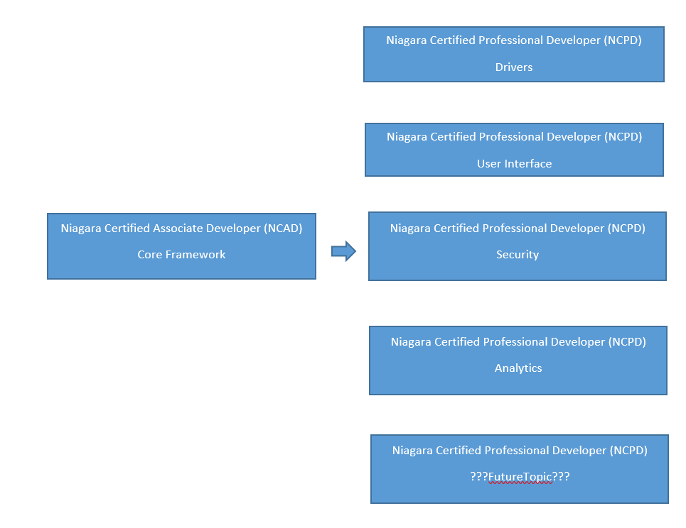
Niagara 4 Developer eLearning
NCAD-CORE: Core Niagara Framework Architecture and Fundamentals
Unit | Topic
1 | Course Overview and Expectations
2 | Create a Station Tutorial
3 | Infrastructure and Architecture Overview
4 | Niagara Framework Overview
5 | Niagara Framework Development Tools
6 | Niagara Object Model
7 | Niagara Component Model
8 | Slot-o-Matic
9 | Program Objects
10 | Ord, BQL, And NEQL Queries
11 | Advanced Developer Tools
12 | Logging And Spy Pages
13 | Unit Testing Using TestNg
14 | Licensing
15 | Niagara Runtime Engine
16 | MixIns
17 | Documentation

Slide 72
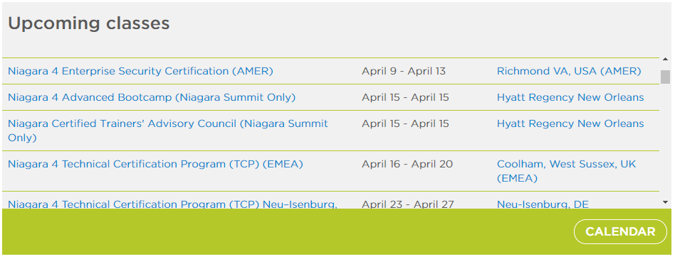
Q2 Upcoming Classes

Slide 73
New Courses
Niagara 4 Enterprise Security –Apr 9-13
Niagara 4 Advanced TCP – May 7-11 (Stanford) & May 14-18 (Richmond)
E-signature Certification (Virtual) – Apr 25 & May 23
Niagara 4 End User – May 22-24
Niagara 4 Analytics End User eLearning

Slide 74


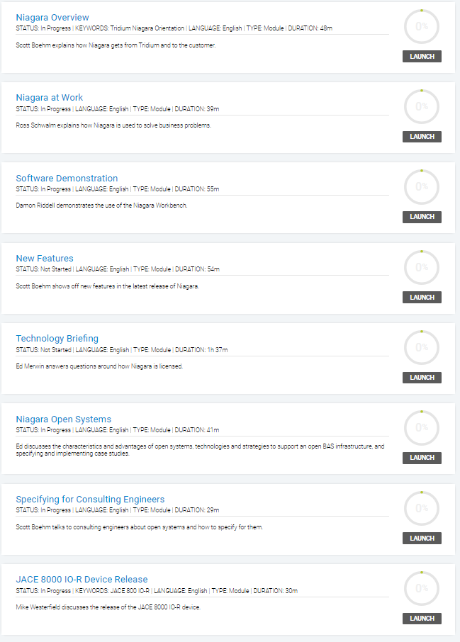



Niagara 101 – Sales Training
Notes:
Five modules
Recorded, edited, and made available to Tridium Employees
Quiz to reinforce what was learned

Slide 75
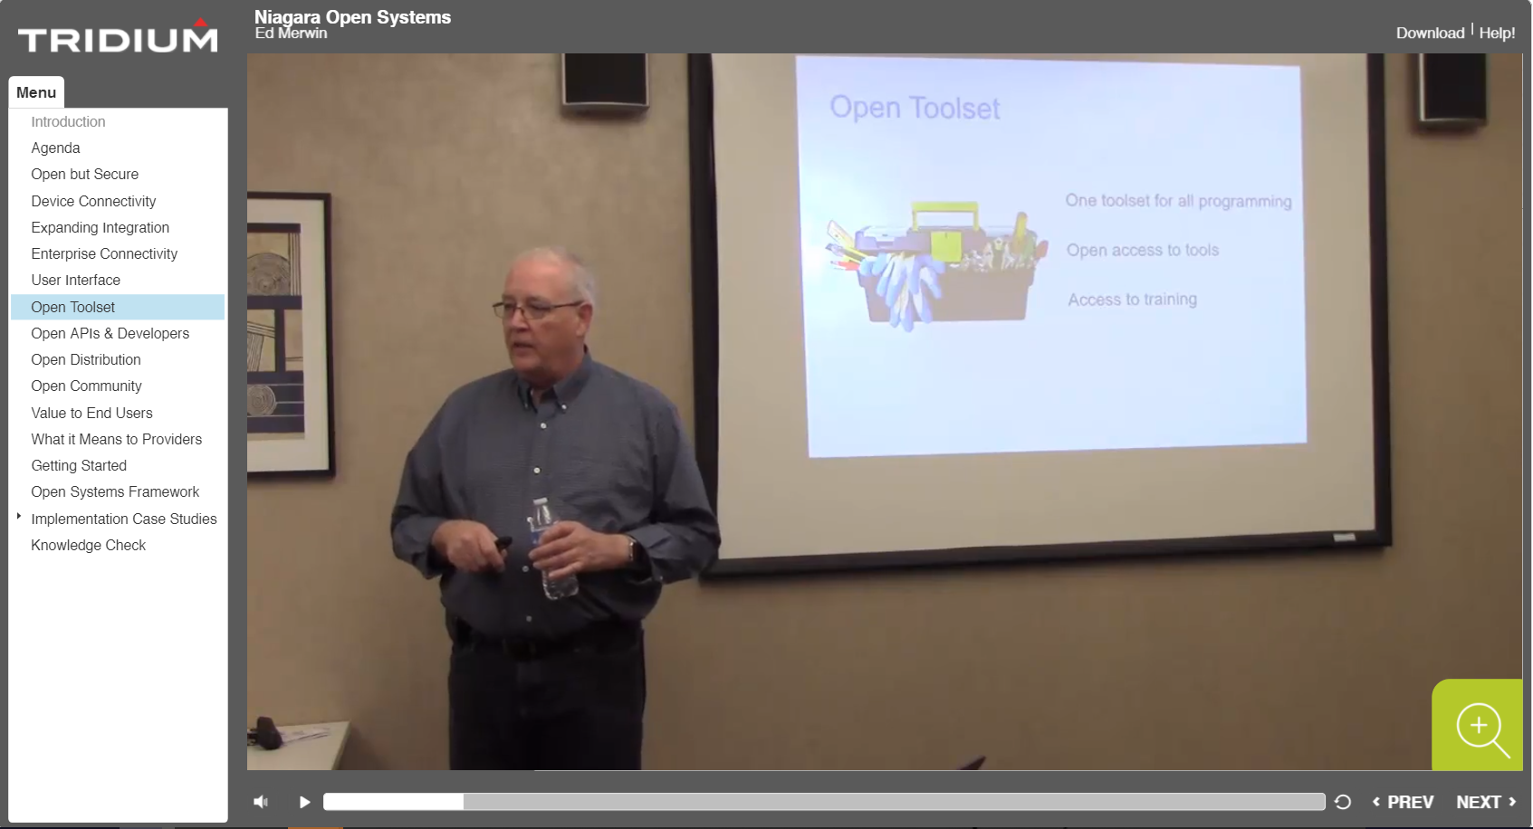
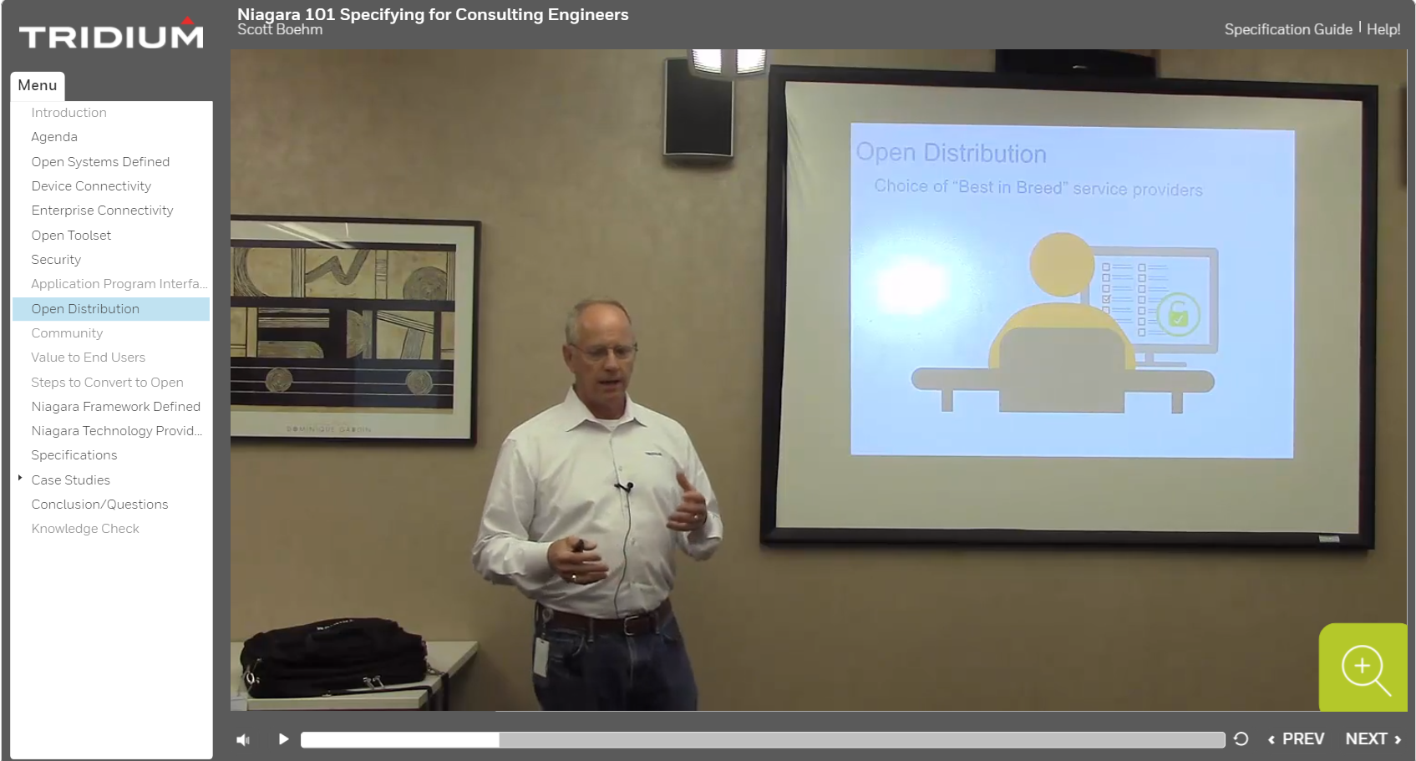
Niagara 4 Sales Certification : July 16-20
Ed Merwin, Scott Boehm, Jon Jarvis
July 16-20 in Richmond VA
2.5 day Bootcamp
Pre-req’s – Tridium New Hire
  Introduction to Niagara 4
Happy to get input/involvement

Slide 76
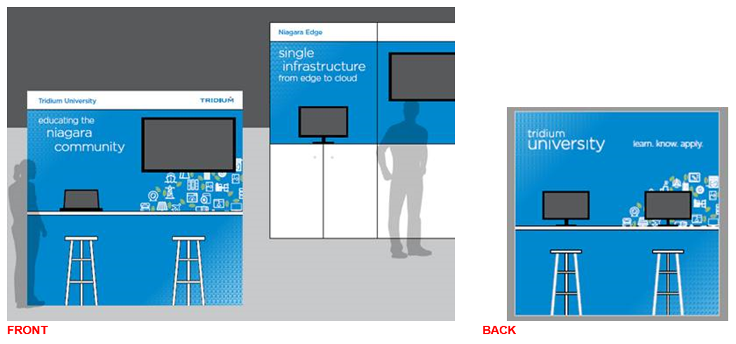
Training Kiosk Booth

Slide 77
Questions?
.

